Slide 1
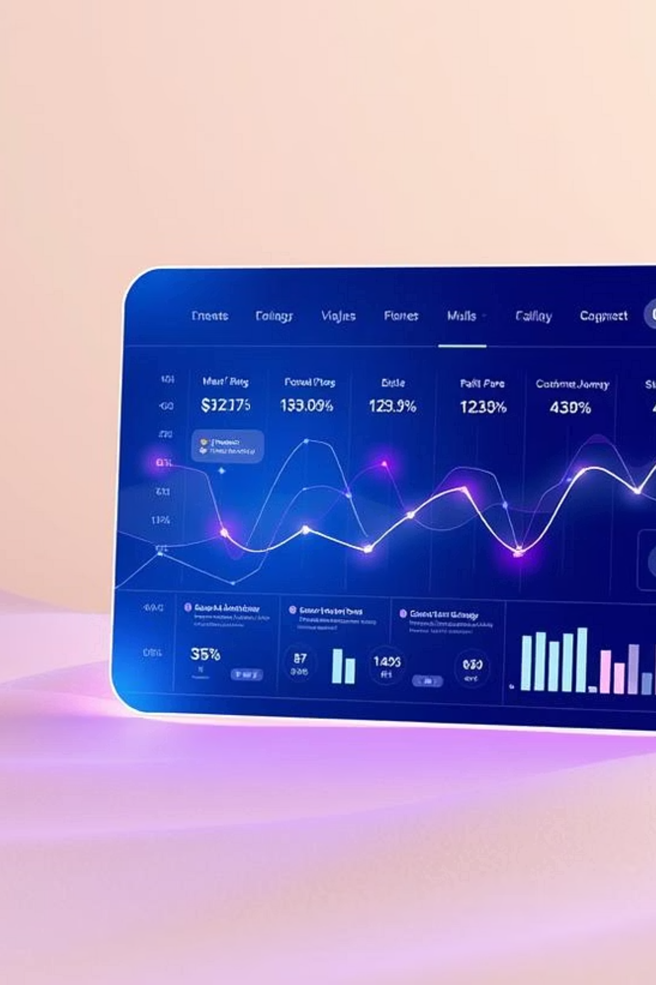
Understanding & Predicting Customer Purchase Intent on E-Commerce Platforms Using Machine Learning
Student: Rishu DixitInstitution: Northwood UniversityCourse: Solve Problem with Machine LearningInstructor: Dr. Itauma, Itauma

Slide 2

Focus of the study : Anticipating Shopper Behavior
This research explores supervised machine learning to predict customer purchases based on session behavior. Using the Online Shoppers Purchasing Intention Dataset (12,000+ records), we evaluated Logistic Regression, Decision Tree, and Random Forest classifiers. Random Forest performed best, showing strong correlations between behavioral patterns and purchase decisions, offering insights for targeted marketing.

Slide 3



Introduction: Evolving Digital Commerce
The digital commerce landscape is rapidly evolving, with companies focused on understanding customer behavior. Online platforms generate vast data, but converting browsing into purchases remains a challenge. Predicting purchase intent empowers platforms to engage users effectively through targeted marketing and personalized content.
Market Growth
Customer Insights
Conversion Challenge
Rapid evolution of digital commerce.
Understanding user interaction data.
Turning browsing into purchases.

Slide 4
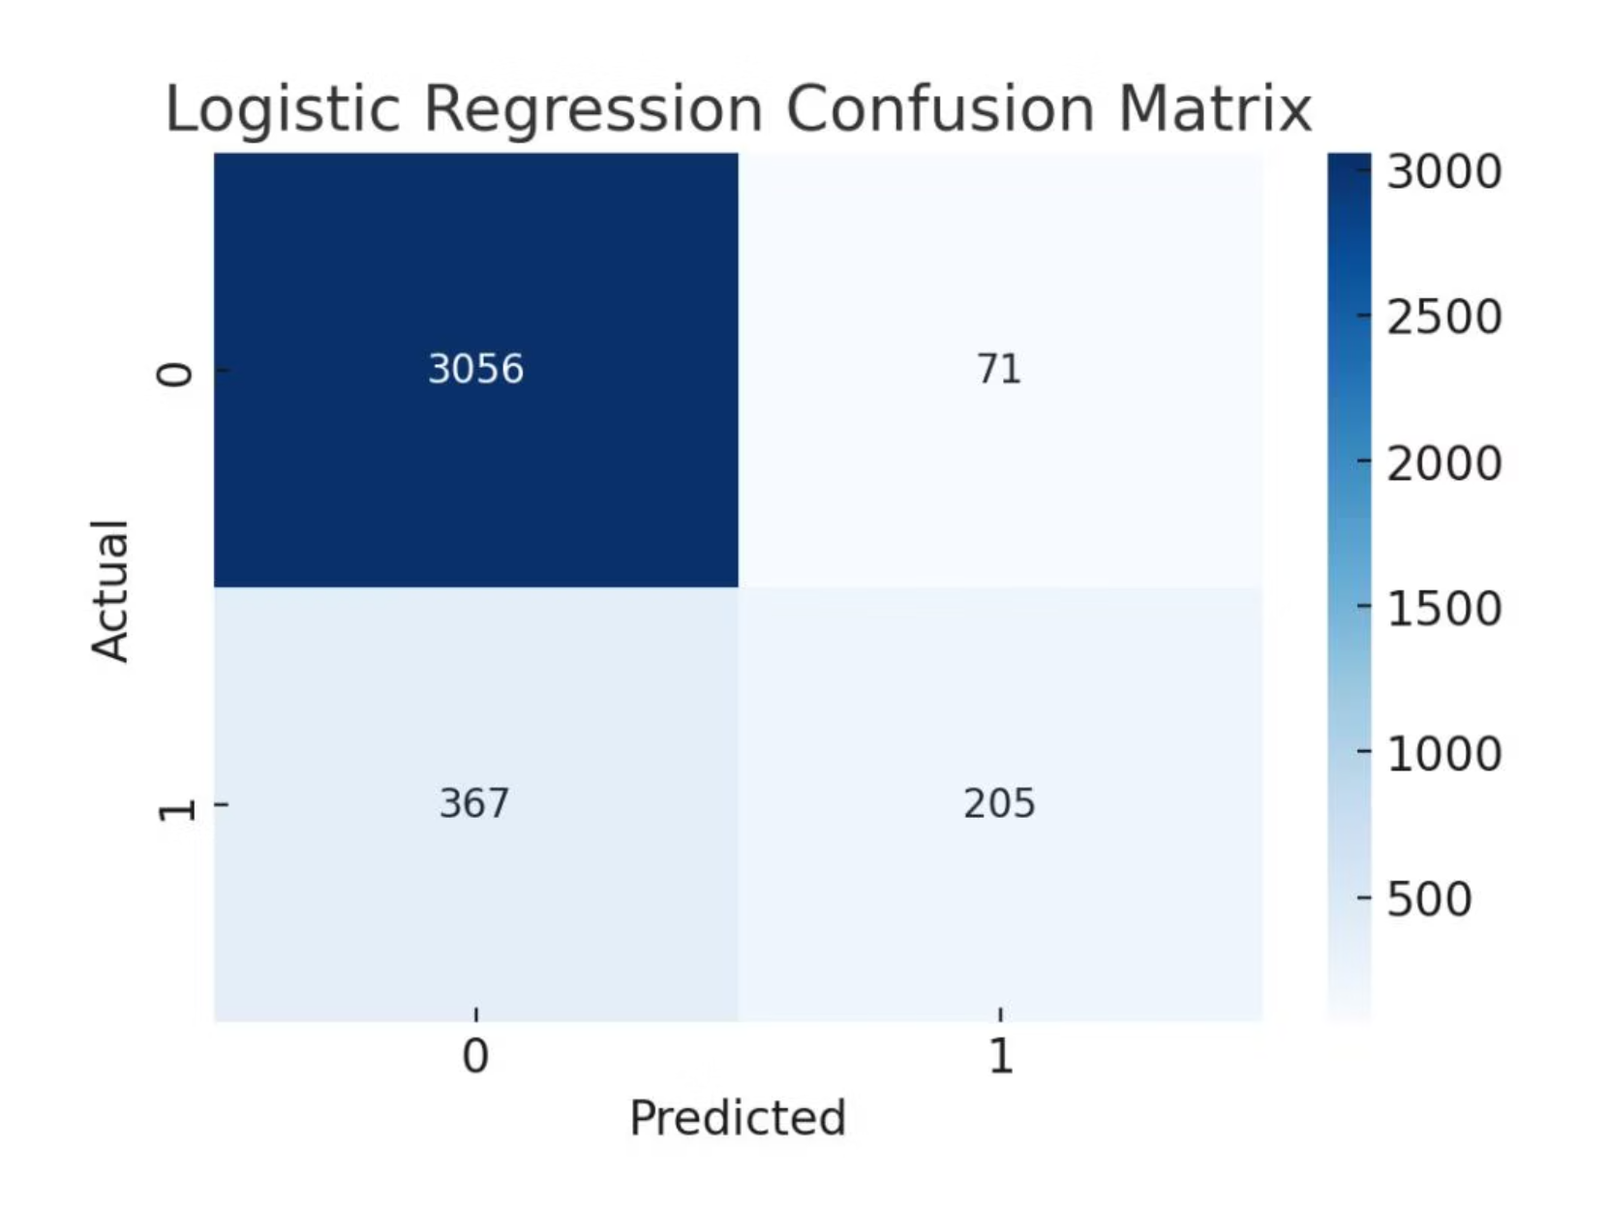
Methodology: Dataset Overview
Our project used the Online Shoppers Purchasing Intention Dataset from UCI ML Repository, containing 12,330 browsing sessions. Features include page visits, duration, exit/bounce rates, and technical attributes. The target variable, "Revenue," indicates a purchase.
Data Preprocessing
No missing values, preserving all records.
Categorical variables (VisitorType, Month) transformed using label encoding.
Numerical features standardized with Z-score normalization.
Data split 70-30 into training and test sets with stratified sampling.

Slide 5
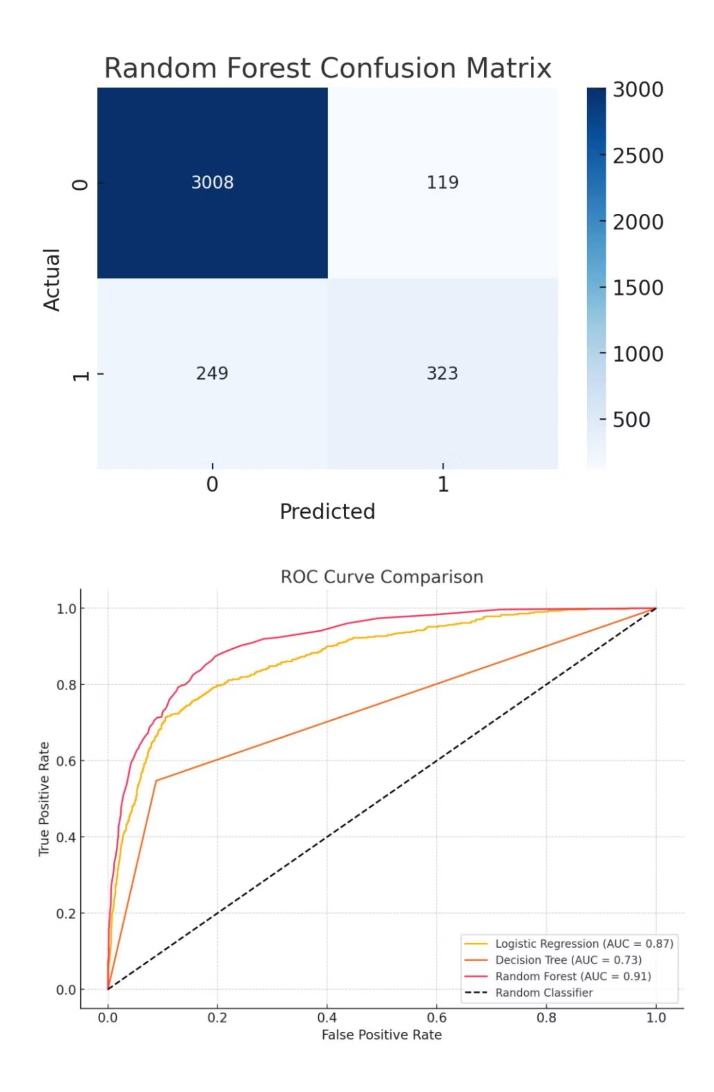
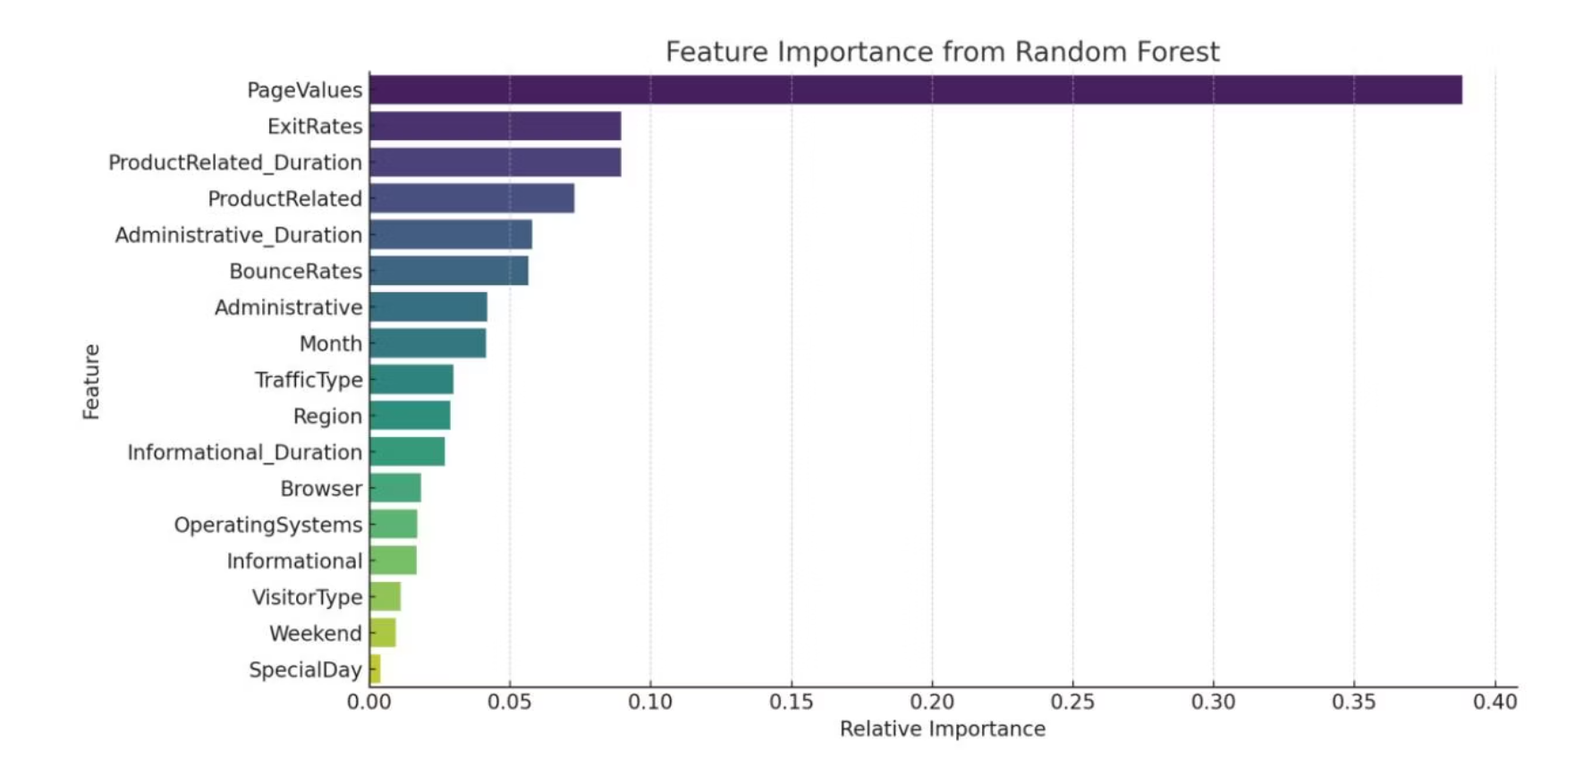
Exploratory Data Analysis (EDA)
EDA revealed strong correlations between Page Values, ExitRates, and ProductRelated Duration with purchase intent. Histograms and boxplots showed that sessions with purchases had longer durations and more product page views, highlighting key predictors.

Slide 6



Machine Learning Models Used
We applied three supervised learning algorithms, balancing performance with transparency for practical application.
Logistic Regression
Decision Tree Classifier
Random Forest Classifier
Selected for interpretability and simplicity, establishing a baseline.
Chosen for modeling non-linear relationships and easy interpretation.
Ensemble model for robust predictions and high performance.

Slide 7
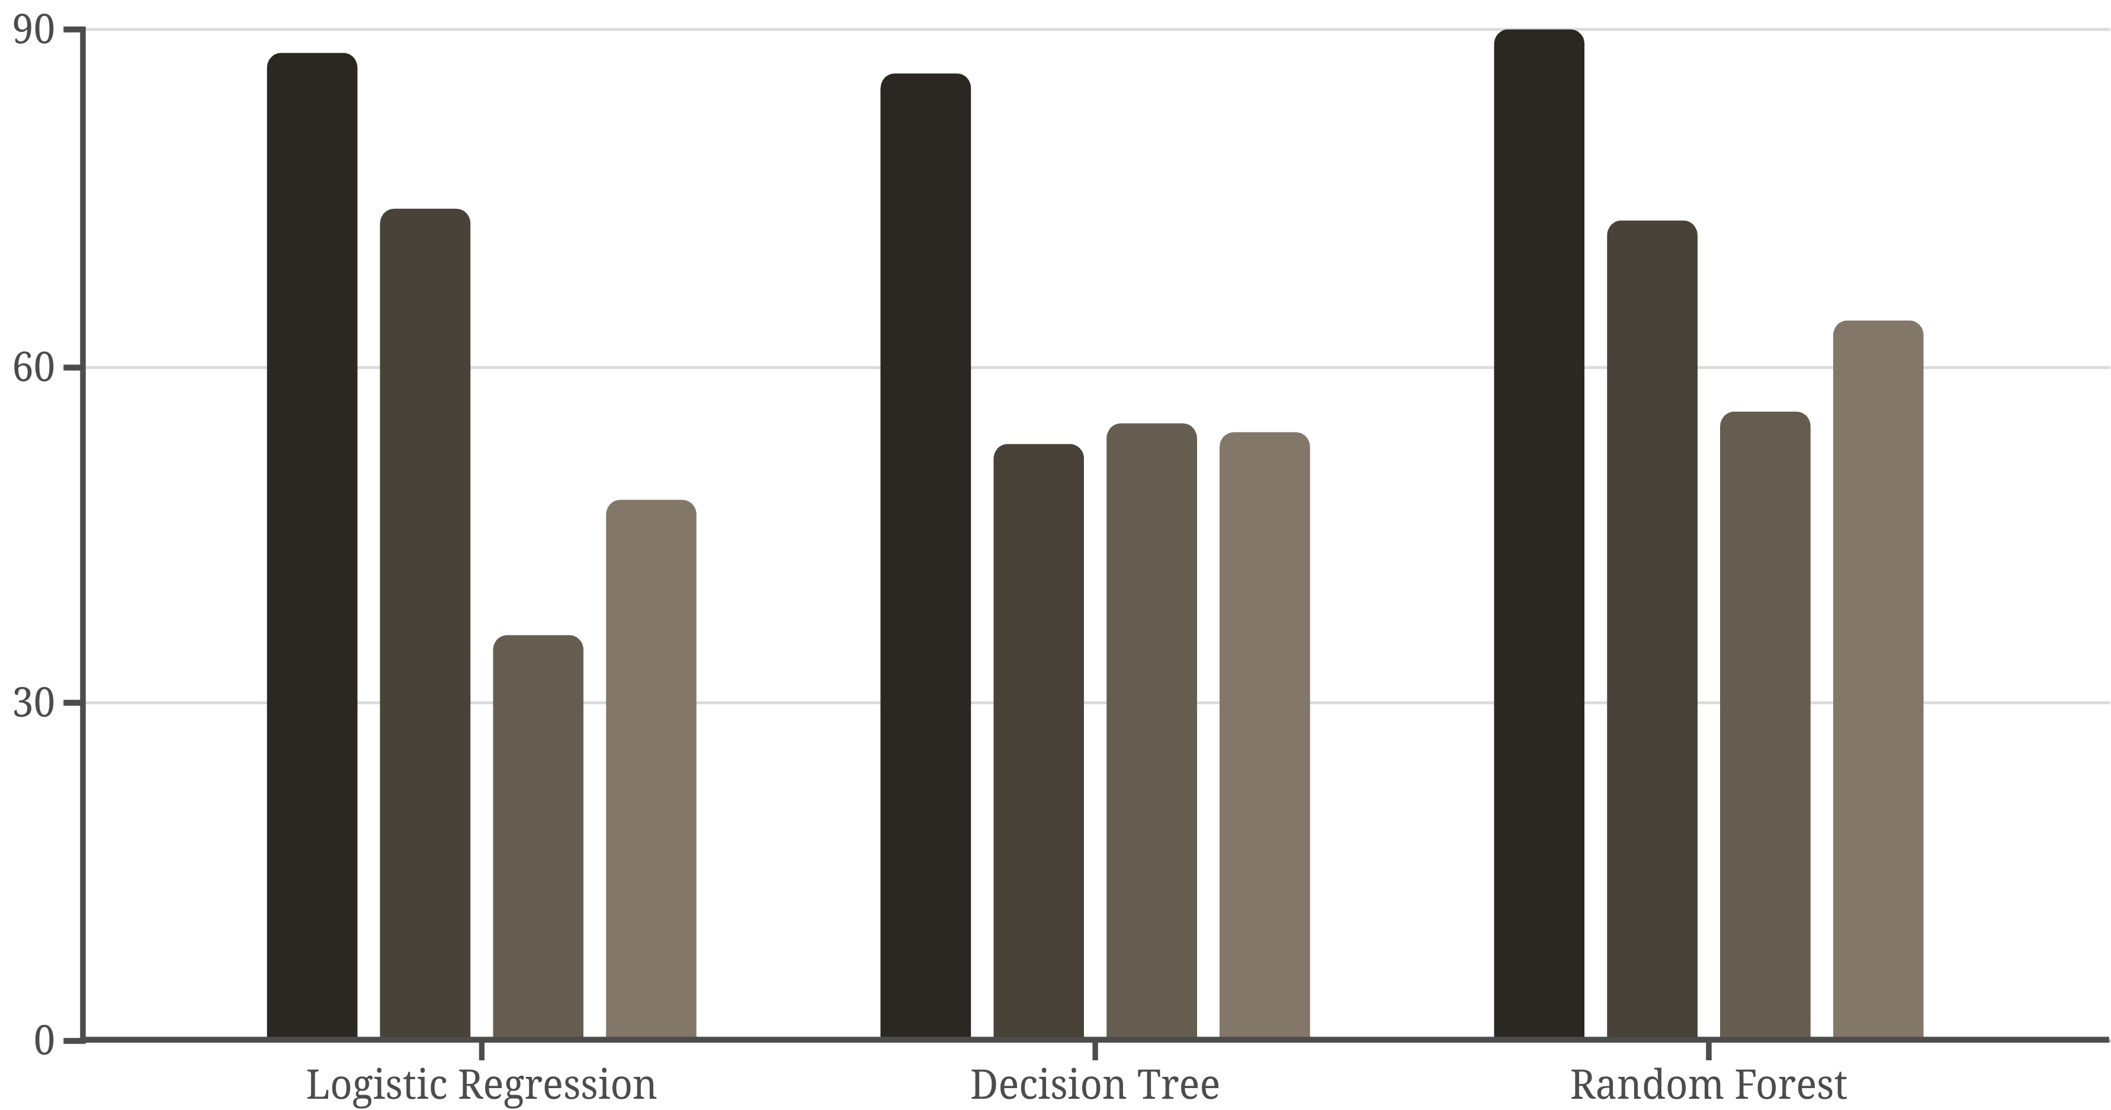
Model Optimization and Validation
We used Grid SearchCV with 5-fold cross-validation to fine-tune Random Forest hyperparameters, ensuring generalizability and reducing overfitting. Evaluation focused on accuracy, precision, recall, and F1-score due to class imbalance.
Accuracy
Precision (1)
Recall (1)
F1-Score (1)

Slide 8
Discussion: Key Findings
Behavioral attributes are strong indicators of purchase intent. Random Forest showed the highest accuracy and generalization, outperforming Logistic Regression and Decision Trees. These findings align with literature, reinforcing the value of session-based features for targeted strategies.
Challenges
Ethical Considerations
Peer Review Impact
Dataset imbalance required careful validation and stratified sampling.
Transparency, data privacy, and fairness are crucial when using behavioral data.
Feedback improved evaluation depth and discussion on model interpretability.

Slide 9
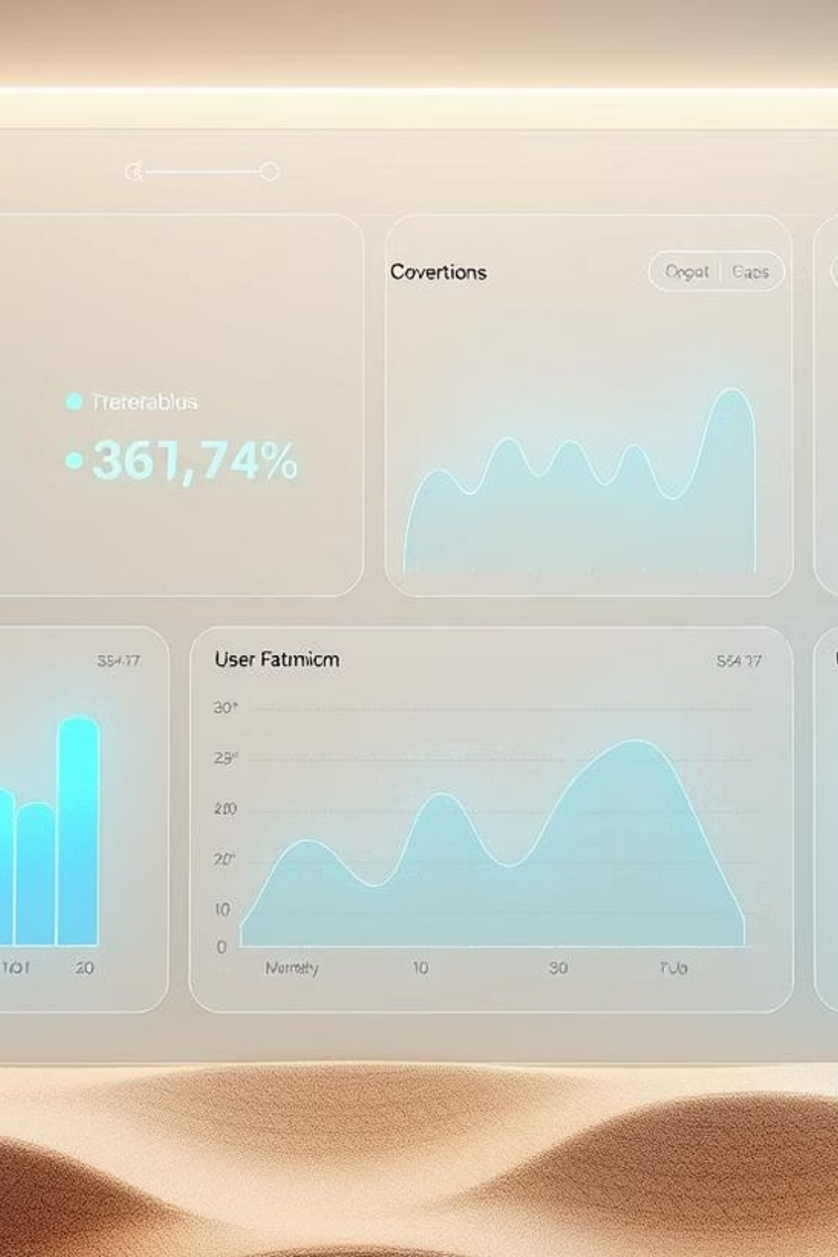
Conclusion & Future Work
Supervised machine learning effectively predicts customer purchase intent, with Random Forest being most effective. These insights offer actionable strategies for digital marketers. Future work includes incorporating demographic data and testing advanced models like LSTM for real-world impact.

